Slide 1
Multiprocessor System
Group 2

Slide 2
Members
Bùi Đức Hiếu 7140231

Slide 3
Multiprocessor System
Multiprocessing is the use two (or more) CPU within a single computer system.
Each sharing main memory and peripherals, to simultaneously process programs.

Slide 4
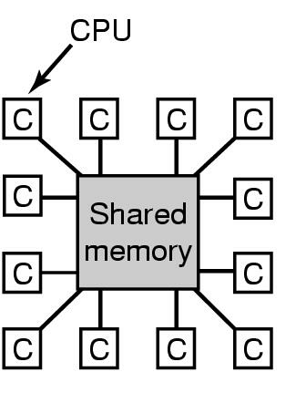
Multiprocessor System
A computer system in which two or more CPUs share full access to a common RAM
The CPU can write some value into the memory and then read the word back and get a different value.

Slide 5
Multiprocessor System
In a multiprocessing system, all CPUs may be equal, or some may be reserved for special purposes.
Processors can be used to execute a single sequence of instructions in multiple contexts.

Slide 6
Multiprocessor System
Processor coupling (the way memory is organized)
  Tightly coupled multiprocessor system
  Loosely coupled multiprocessor system

Slide 7
Tightly coupled MS
Tightly coupled multiprocessor systems contain multiple CPUs that are connected at the bus level.
These CPUs may have access to a central shared memory (SMP or UMA), or may participate in a memory hierarchy with both local and shared memory (NUMA).

Slide 8
Loosely coupled MS
Loosely coupled multiprocessor systems (often referred to as clusters) are based on multiple standalone single or dual processor commodity computers interconnected via a high speed communication system.

Slide 9
Multiprocessor Hardware
UMA (Uniform Memory Access) Multiprocessors
  UMA Bus-Based SMP Architecture
  UMA Multiprocessors using Crossbar Switches
  UMA Multiprocessors using Multistage Switching Networks
NUMA (NonUniform Memory Access) Multiprocessor

Slide 10
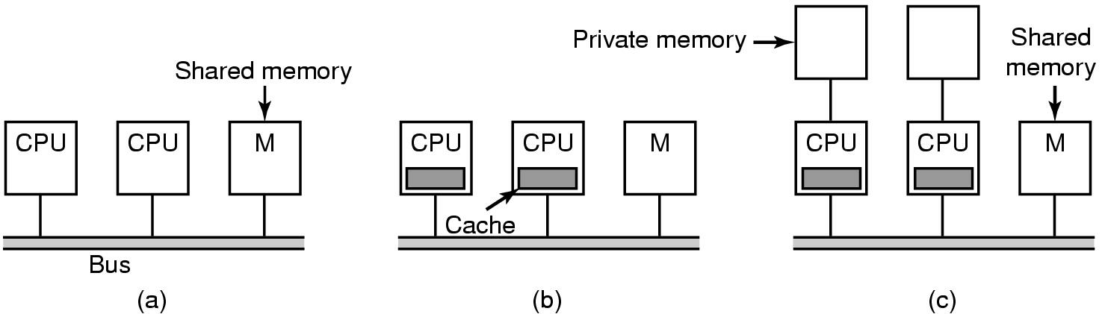
UMA Bus-Based SMP Architectures
  (a) without caching
  (b) with caching
  (c) with caching and private memories

Slide 11
UMA Bus-Based SMP Architectures
Two or more CPUs and one or more memory modules all use the same BUS communication.
If the bus is busy when a CPU wants to read or write on memory, the CPU just waits until the bus becomes idle.

Slide 12
UMA Bus-Based SMP Architectures
There will be much less bus traffic, and the system can support more CPUs.
If the CPU attempts to write a word that is in one or more remote caches, the BUS hardware detects the write and puts a signal on the informing all other caches of the write

Slide 13
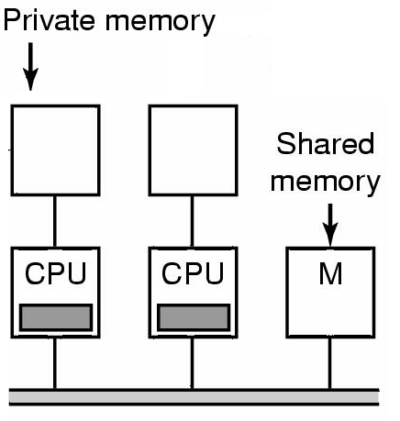
UMA Bus-Based SMP Architectures
The compiler should place all the program text, strings, constants and other read-only data & local variables in the private memories
The shared memory is then only used for writable shared variables.

Slide 14
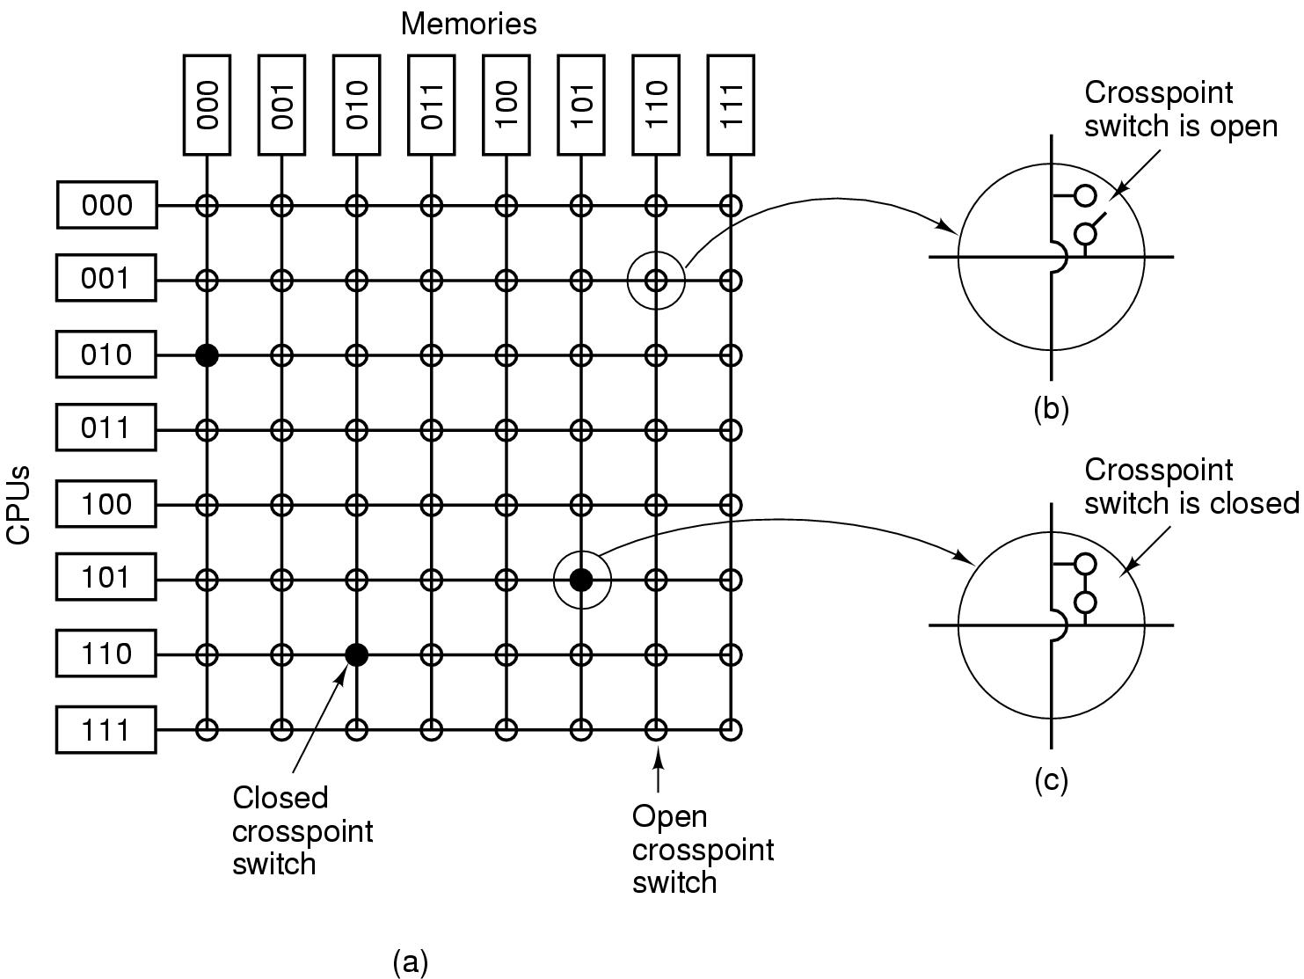
UMA MPs - Crossbar Switches
CROSSPOINT – is a small switch that can be electrically opened or closed.

Slide 15
UMA MPs - Crossbar Switches
The best properties of the crossbar switch is that it is a NONBLOCKING NETWORK.
“No CPU is ever denied the connections its needs”
The worst properties of the crossbar switch is the fact that the number of crosspoints grows (n²).

Slide 16
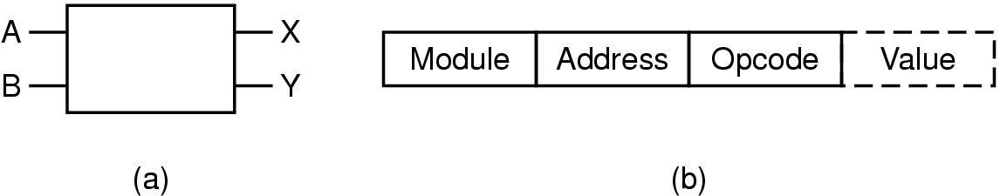
UMA MPs - Multistage Switching Network
2x2 switch
Message format
Message Format
  Module → It tell which memory to use.
  Address → It specifies an address within a module
  Opcode → Gives the operation, READ or WRITE
  Value → Contain an operand.

Slide 17
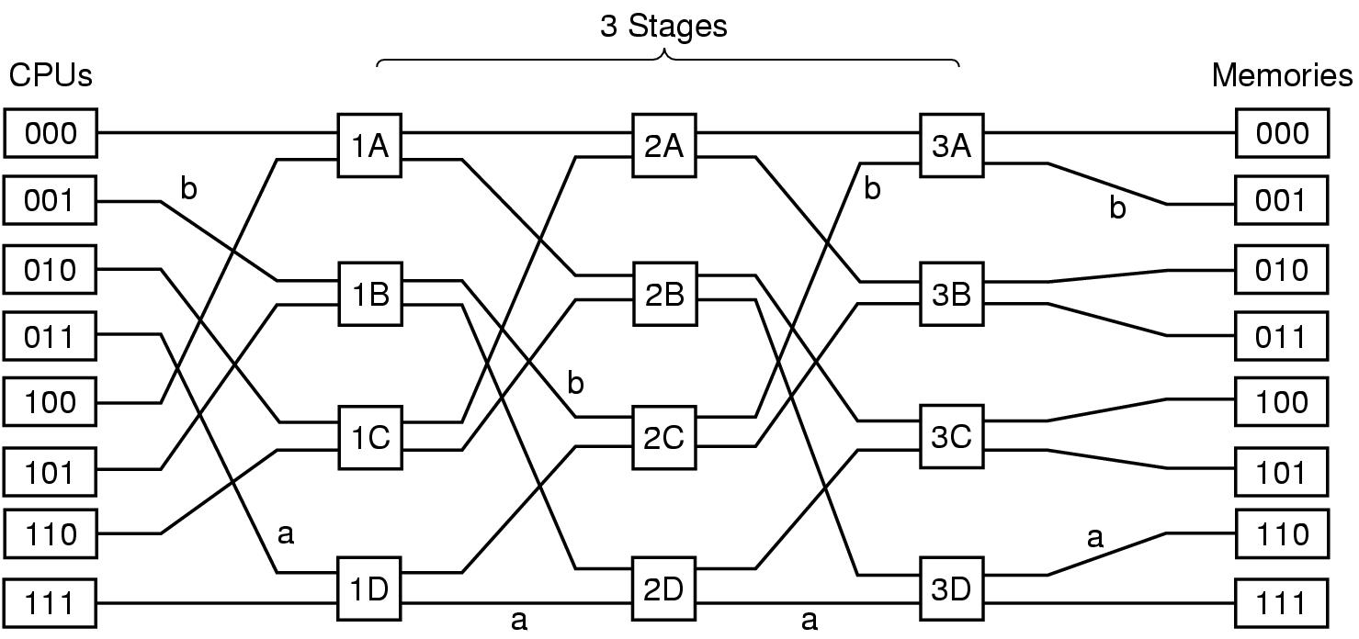
UMA MPs - Multistage Switching Network
Omega Switching Network
Number of Stages = (Log₂n)
Number of Switches per Stage = (n/2),
Total Switches = (n/2)Log₂n

Slide 18
NUMA Multiprocessors
NUMA Machines 3 Key Characteristics:
  There is a single address visible to all CPUs
  Access to remote memory is via LOAD and STORE instructions
  Access to REMOTE MEMORY is slower than access to LOCAL MEMORY
NC-NUMA (No Caching) - access time to remote memory is not hidden
CC-NUMA (Cache-Coherent) – caches are present.

Slide 19
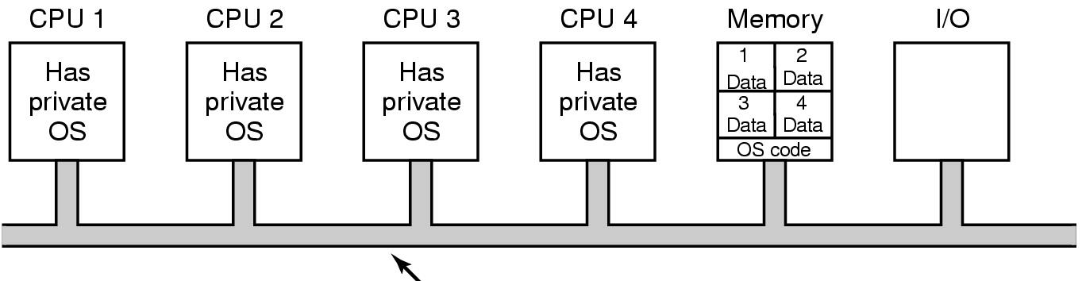
Multiprocessor Operating System Types
Each CPU Has Its Own Operation System
The memory divide into as many partition as there are CPUs and give each CPU its own private memory and its own private copy of Operating System

Slide 20
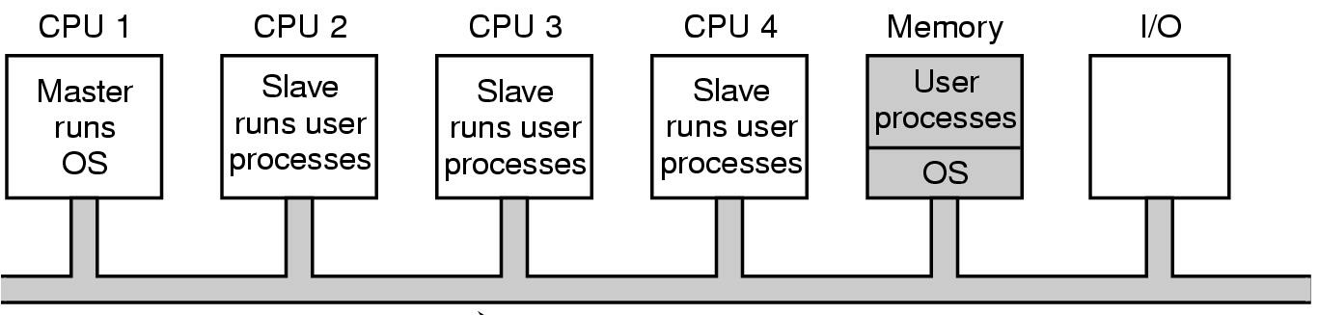
Multiprocessor Operating System Types
Master-Slave Multiprocessors
There is one copy of the operating system and its table are present to CPU1.
All system calls are redirected to CPU1

Slide 21
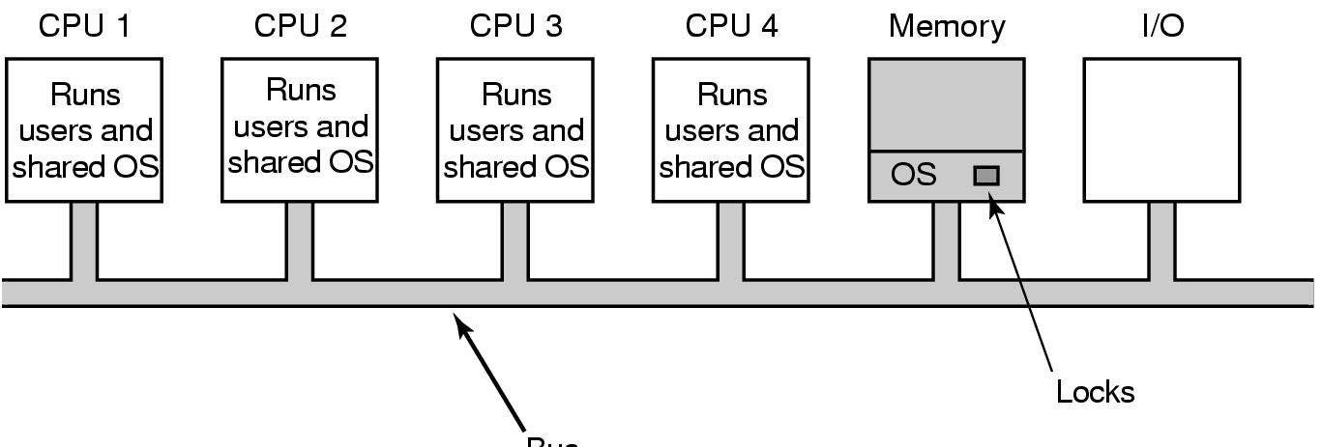
Multiprocessor Operating System Types
Symmetric Multiprocessors (SMP)
There is one copy of the OS in memory but any CPU can run it.
If the two CPU simultaneously picking the same process to run the same memory page. It associate a MUTEX(Lock) with OS.

Slide 22
Thank you for attention
Q & A

